Slide 1
Home-FTP
Home FTP is a LAN-Based file transfer app.
The goal is to easily exchange a large amount of data in a local area network environment.
After you launched Home FTP, you will see all other people and their sharing data automatically without special configuration.
FTP does not really move ,it copies files from one computer to another computer

Slide 2

Honorable Supervisor
Dr. Saleh Ahmed
Associate Professor
Department of CSE, BSMRSTU.

Slide 3


Team Members
Yeasin Arafat
ID: 18ICTCSE003
Department of CSE, BSMRSTU.
Roksana Akter
ID:18ICTCSE004
Department of CSE, BSMRSTU.

Slide 4
Home-FTP::Features
File Share
Public share
Private share(peer to peer)
File Receive
Download from FTP
Download Private File
Host Management
Add new host
Delete existing host
Settings
Profile Name modification
File path modification

Slide 5
Home FTP::Technology & Tools
Programming Language:
Java Swing
Java Socket Programming
OOP Concepts
Networking Concept:
TCP Connection
Tools
Visual Studio Code
JDK Development Kit 20.0.1

Slide 6
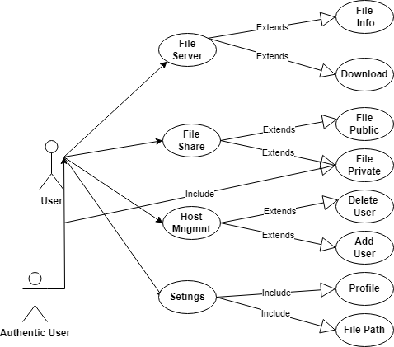
Home FTP:: Use Case Diagram

Slide 7
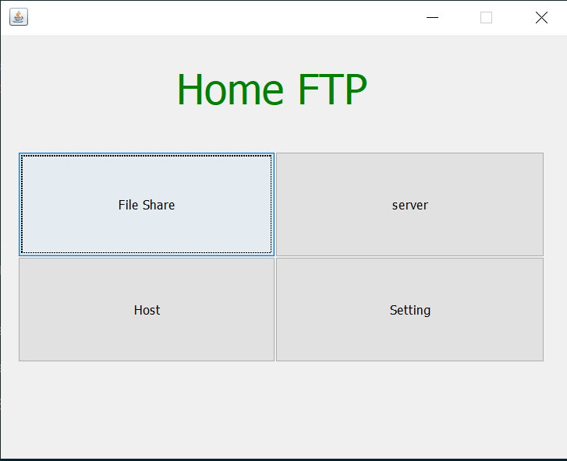
Home FTP::Home Page

Slide 8
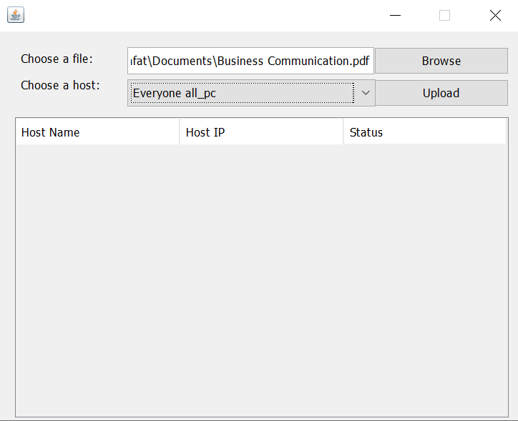
Home FTP::File Share Page

Slide 9
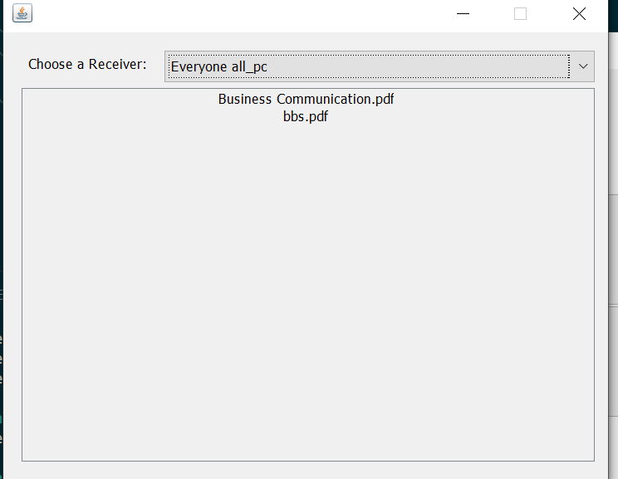
Home FTP::Server Page

Slide 10
Home FTP
Thank You

